Slide 1
Unit 7:
Design and Implementation

Slide 2
Design and Implementation
Software design and implementation is the stage in the software engineering process at which an executable software system is developed.
For some simple systems, software design and implementation is software engineering, and all other activities are merged with this process.
For large systems, software design and implementation is only one of a set of processes (requirements engineering, verification and validation, etc.) involved in software engineering

Slide 3
Design and Implementation
Software design and implementation activities are invariably interleaved.
Software design is a creative activity in which you identify software components and their relationships, based on a customer’s requirements.
Implementation is the process of realizing the design as a program.
Design is about how to solve a problem, so there is always a design process.
Design and implementation are closely linked and you should normally take implementation issues into account when developing a design. For example, using the UML to document a design may be the right thing to do if you are programming in an object-oriented language such as Java or C#.

Slide 4
Object-oriented design using the UML
Object-oriented systems are easier to change than systems developed using functional approaches.
Objects include both data and operations to manipulate that data. They may therefore be understood and modified as stand-alone entities.
Changing the implementation of an object or adding services should not affect other system objects. Because objects are associated with things, there is often a clear mapping between real world entities (such as hardware components) and their controlling objects in the system. This improves the understandability, and hence the maintainability, of the design.

Slide 5
Object-oriented design using the UML
To develop a system design from concept to detailed, object-oriented design, there are several things that you need to do:
Understand and define the context and the external interactions with the system.
Design the system architecture
Identify the principal objects in the system.
Develop design models.
Specify interfaces.

Slide 6
Object-oriented design using the UML
System context and interactions
The first stage in any software design process is to develop an understanding of the relationships between the software that is being designed and its external environment.
This is essential for deciding how to provide the required system functionality and how to structure the system to communicate with its environment.
Understanding of the context also lets you establish the boundaries of the system.
Setting the system boundaries helps you decide what features are implemented in the system being designed and what features are in other associated systems.

Slide 7
Object-oriented design using the UML
System context and interactions
System context models and interaction models present complementary views of the relationships between a system and its environment:
A system context model is a structural model that demonstrates the other systems in the environment of the system being developed.
An interaction model is a dynamic model that shows how the system interacts with its environment as it is used.

Slide 8
Object-oriented design using the UML
System context and interactions
The context model of a system may be represented using associations.
Associations simply show that there are some relationships between the entities involved in the association.
The nature of the relationships is now specified.
You may therefore document the environment of the system using a simple block diagram, showing the entities in the system and their associations.

Slide 9
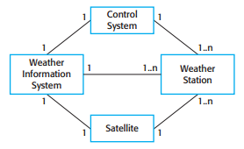
Object-oriented design using the UML
System context and interactions
In this case, you need to decide how functionality is distributed between the control system for all of the weather stations, and the embedded software in the weather station itself.
System context for the weather station

Slide 10
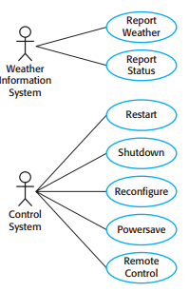
Object-oriented design using the UML
System context and interactions
When you model the interactions of a system with its environment you should use an abstract approach that does not include too much detail.
One way to do this is to use a use case model.
Weather station use cases

Slide 11
Object-oriented design using the UML
System context and interactions
Each of the use cases should be described in structured natural language. This helps designers identify objects in the system and gives them an understanding of what the system is intended to do.

Slide 12
Object-oriented design using the UML
Architectural design
Once the interactions between the software system and the system’s environment have been defined, you use this information as a basis for designing the system architecture.
You need to combine this with your general knowledge of the principles of architectural design and with more detailed domain knowledge.

Slide 13
Object-oriented design using the UML
Architectural design
You identify the major components that make up the system and their interactions, and then may organize the components using an architectural pattern such as a layered or client–server model.

Slide 14
Object-oriented design using the UML
Architectural design
The high-level architectural design for the weather station software The weather station is composed of independent subsystems that communicate by broadcasting messages on a common infrastructure, shown as the Communication link.
Each subsystem listens for messages on that infrastructure and picks up the messages that are intended for them. This is another commonly used architectural style.

Slide 15
Object-oriented design using the UML
Object class identification
After understanding system context and implementation and use case diagram and we usually need a high-level system object or objects that encapsulate the system interactions defined in the use cases. With these objects in mind, you can start to identify the object classes in the system.

Slide 16
Object-oriented design using the UML
Object class identification
There have been various proposals made about how to identify object classes in object-oriented systems:
Use a grammatical analysis of a natural language description of the system to be constructed. Objects and attributes are nouns; operations or services are verbs.
Use tangible entities (things) in the application domain roles such as manager or doctor, events such as requests, interactions such as meetings, locations such as offices, organizational units such as companies, and so on
Use a scenario-based analysis where various scenarios of system use are identified and analyzed in turn. As each scenario is analyzed, the team responsible for the analysis must identify the required objects, attributes, and operations .

Slide 17
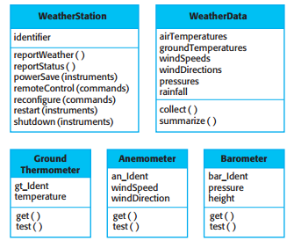
Object-oriented design using the UML
Object class identification
Weather station objects

Slide 18
Object-oriented design using the UML
Design models
Design or system models show the objects or object classes in a system.
They also show the associations and relationships between these entities.
These models are the bridge between the system requirements and the implementation of a system.
They have to be abstract so that unnecessary detail doesn’t hide the relationships between them and the system requirements.
However, they also have to include enough detail for programmers to make implementation decisions

Slide 19
Object-oriented design using the UML
Design models
Generally, you get around this type of conflict by developing models at different levels of detail.
Where there are close links between requirements engineers, designers, and programmers, then abstract models may be all that are required.
Specific design decisions may be made as the system is implemented, with problems resolved through informal discussions.
When the links between system specifiers, designers, and programmers are indirect (e.g., where a system is being designed in one part of an organization but implemented elsewhere), then more detailed models are likely to be needed.

Slide 20
Object-oriented design using the UML
Design models
When you use the UML to develop a design, you will normally develop two kinds of design model:
Structural models, which describe the static structure of the system using object classes and their relationships. Important relationships that may be documented at this stage are generalization (inheritance) relationships, uses/used-by relationships, and composition relationships.
Dynamic models, which describe the dynamic structure of the system and show the interactions between the system objects. Interactions that may be documented include the sequence of service requests made by objects and the state changes that are triggered by these object interactions.

Slide 21
Object-oriented design using the UML
Design models
In the early stages of the design process, there are three models that are particularly useful for adding detail to use case and architectural mode is:
Subsystem models, which that show logical groupings of objects into coherent subsystems. These are represented using a form of class diagram with each subsystem shown as a package with enclosed objects. Subsystem models are static (structural) models.
Sequence models, which show the sequence of object interactions. These are represented using a UML sequence or a collaboration diagram. Sequence models are dynamic models.
State machine model, which show how individual objects change their state in response to events. These are represented in the UML using state diagrams. State machine models are dynamic models.

Slide 22
Object-oriented design using the UML
Design models
A subsystem model is a useful static model as it shows how a design is organized into logically related groups of objects. As well as subsystem models, you may also design detailed object models, showing all of the objects in the systems and their associations (inheritance, generalization, aggregation, etc.). However, there is a danger in doing too much modeling. You should not make detailed decisions about the implementation that really should be left to the system programmers.
Sequence models are dynamic models that describe, for each mode of interaction, the sequence of object interactions that take place. When documenting a design, you should produce a sequence model for each significant interaction. If you have developed a use case model then there should be a sequence model for each use case that you have identified.

Slide 23
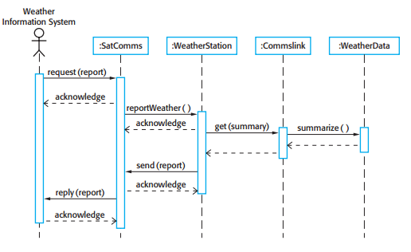
Object-oriented design using the UML
Design models
Sequence diagram describing data collection
This diagram shows the sequence of interactions that take place when an external system requests the summarized data from the weather station.

Slide 24
Object-oriented design using the UML
Design models
Sequence diagrams are used to model the combined behavior of a group of objects but you may also want to summarize the behavior of an object or a subsystem in response to messages and events.
To do this, you can use a state machine model that shows how the object instance changes state depending on the messages that it receives.
The UML includes state diagrams, initially invented by Harel (1987) to describe state machine models

Slide 25
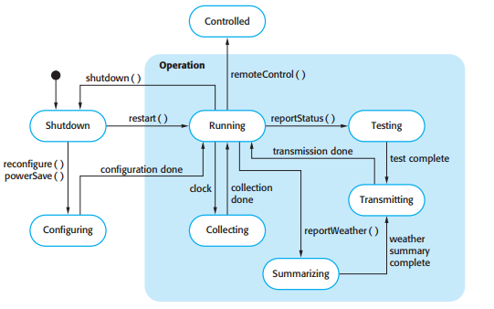
Object-oriented design using the UML
Design models
Weather station state diagram

Slide 26
Object-oriented design using the UML
Design models
State diagrams are useful high-level models of a system or an object’s operation.
You don’t usually need a state diagram for all of the objects in the system.
Many of the objects in a system are relatively simple and a state model adds unnecessary detail to the design.

Slide 27
Object-oriented design using the UML
Interface specification
An important part of any design process is the specification of the interfaces between the components in the design.
You need to specify interfaces so that objects and subsystems can be designed in parallel.
Once an interface has been specified, the developers of other objects may assume that interface will be implemented.
Interface design is concerned with specifying the detail of the interface to an object or to a group of objects.
This means defining the signatures and semantics of the services that are provided by the object or by a group of objects.

Slide 28
Object-oriented design using the UML
Interface specification
Interfaces can be specified in the UML using the same notation as a class diagram. However, there is no attribute section and the UML stereotype ‹‹interface›› should be included in the name part.
The semantics of the interface may be defined using the object constraint language (OCL).
You should not include details of the data representation in an interface design, as attributes are not defined in an interface specification. However, you should include operations to access and update data.

Slide 29
Design Patterns
Design patterns were derived from ideas put forward by Christopher Alexander, who suggested that there were certain common patterns of building design that were inherently pleasing and effective.
The pattern is a description of the problem and the essence of its solution, so that the solution may be reused in different settings.
The pattern is not a detailed specification. Rather, you can think of it as a description of accumulated wisdom and experience, a well-tried solution to a common problem.

Slide 30
Design Patterns
A quote from the Hillside Group web site, which is dedicated to maintaining information about patterns, encapsulates their role in reuse:
Patterns and Pattern Languages are ways to describe best practices, good designs, and capture experience in a way that it is possible for others to reuse this experience.

Slide 31
Design Patterns
Design patterns are usually associated with object-oriented design.
Published patterns often rely on object characteristics such as inheritance and polymorphism to provide generality.
However, the general principle of encapsulating experience in a pattern is one that is equally applicable to any kind of software design.
So, you could have configuration patterns for COTS systems.
Patterns are a way of reusing the knowledge and experience of other designers.

Slide 32
Design Patterns
The four essential elements of design patterns were defined by the ‘Gang of Four’ in their patterns book:
A name that is a meaningful reference to the pattern.
A description of the problem area that explains when the pattern may be applied.
A solution description of the parts of the design solution, their relationships, and their responsibilities. It is a template for a design solution that can be instantiated in different ways. This is often expressed graphically and shows the relationships between the objects and object classes in the solution.
A statement of the consequences—the results and trade-offs—of applying the pattern. This can help designers understand whether or not a pattern can be used in a particular situation.

Slide 33
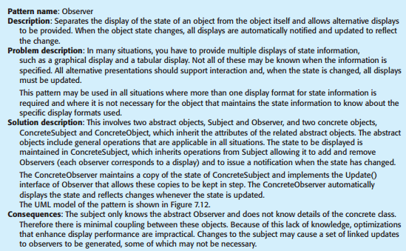
Design Patterns
To illustrate pattern description, the Observer pattern, taken from the book by Gamma et al.
The Observer pattern

Slide 34
Design Patterns
To use patterns in our own design, we need to recognize that any design problem you are facing may have an associated pattern that can be applied.
Examples of such problems, documented in the ‘Gang of Four’s original patterns book, include:
Observer patterns: Tell several objects that the state of some other object has changed.
Façade pattern: Tidy up the interfaces to a number of related objects that have often been developed incrementally .
Iterator pattern: Provide a standard way of accessing the elements in a collection, irrespective of how that collection is implemented.
Decorator pattern: Allow for the possibility of extending the functionality of an existing class at run-time.

Slide 35
Design Patterns
Patterns support high-level, concept reuse.
When you try to reuse executable components you are inevitably constrained by detailed design decisions that have been made by the implementers of these components.
These range from the particular algorithms that have been used to implement the components to the objects and types in the component interfaces.
When these design decisions conflict with your particular requirements, reusing the component is either impossible or introduces inefficiencies into your system.
Using patterns means that you reuse the ideas but can adapt the implementation to suit the system that you are developing.
Patterns are a great idea but you need experience of software design to use them effectively. You have to recognize situations where a pattern can be applied.

Slide 36
Implementation issues
Software engineering includes all of the activities involved in software development from the initial requirements of the system through to maintenance and management of the deployed system.
System implementation an executable version of the software and critical stage of the process model.
Implementation may involve developing programs in high- or low-level programming languages or tailoring and adapting generic, off-the-shelf systems to meet the specific requirements of an organization.

Slide 37
Implementation issues
Some aspects of implementation that are particularly important to software engineering that are often not covered in programming texts.
These are:
Reuse: Most modern software is constructed by reusing existing components or systems. When you are developing software, you should make as much use as possible of existing code.
Configuration management: During the development process, many different versions of each software component are created. If you don’t keep track of these versions in a configuration management system, you are liable to include the wrong versions of these components in your system.

Slide 38
Implementation issues
Host-target development: Production software does not usually execute on the same computer as the software development environment. Rather, you develop it on one computer (the host system) and execute it on a separate computer (the target system). The host and target systems are sometimes of the same type but, often they are completely different.

Slide 39
Implementation issues
Reuse
The only significant reuse or software was the reuse of functions and objects in programming language libraries.
However, costs and schedule pressure meant that this approach became increasingly unviable.

Slide 40
Implementation issues
Reuse
Software reuse is possible at a number of different levels:
The abstraction level: At this level, you don’t reuse software directly but rather use knowledge of successful abstractions in the design of your software. Design patterns and architectural patterns are ways of representing abstract knowledge for reuse.
The object level: At this level, you directly reuse objects from a library rather than writing the code yourself. To implement this type of reuse, you have to find appropriate libraries and discover if the objects and methods offer the functionality that you need.

Slide 41
Implementation issues
Reuse
The component level: Components are collections of objects and object classes that operate together to provide related functions and services. You often have to adapt and extend the component by adding some code of your own.
An example of component-level reuse is where you build your user interface using a framework. This is a set of general object classes that implement event handling, display management, etc. You add connections to the data to be displayed and write code to define specific display details such as screen layout and colors.

Slide 42
Implementation issues
Reuse
The system level: At this level, you reuse entire application systems. This usually involves some kind of configuration of these systems. This may be done by adding and modifying code (if you are reusing a software product line) or by using the system’s own configuration interface.
Most commercial systems are now built in this way where generic COTS (commercial off-the-shelf) systems are adapted and reused. Sometimes this approach may involve reusing several different systems and integrating these to create a new system.

Slide 43
Implementation issues
Reuse
By reusing existing software, you can develop new systems more quickly, with fewer development risks and also lower costs.
There are costs associated with reuse:
The costs of the time spent in looking for software to reuse and assessing whether or not it meets your needs. You may have to test the software to make sure that it will work in your environment, especially if this is different from its development environment.
Where applicable, the costs of buying the reusable software. For large off-the-shelf systems, these costs can be very high.
The costs of adapting and configuring the reusable software components or systems to reflect the requirements of the system that you are developing.

Slide 44
Implementation issues
Reuse
The costs of integrating reusable software elements with each other (if you are using software from different sources) and with the new code that you have developed. Integrating reusable software from different providers can be difficult and expensive because the providers may make conflicting assumptions about how their respective software will be reused.

Slide 45
Implementation issues
Configuration Management
Configuration management is the name given to the general process of managing a changing software system.
The aim of configuration management is to support the system integration process so that all developers can access the project code and documents in a controlled way, find out what changes have been made, and compile and link components to create a system.

Slide 46
Implementation issues
Configuration Management
Three fundamental configuration management activities:
Version management, where support is provided to keep track of the different versions of software components. Version management systems include facilities to coordinate development by several programmers. They stop one developer overwriting code that has been submitted to the system by someone else.
System integration, where support is provided to help developers define what versions of components are used to create each version of a system. This description is then used to build a system automatically by compiling and linking the required components.

Slide 47
Implementation issues
Configuration Management
Problem tracking, where support is provided to allow users to report bugs and other problems, and to allow all developers to see who is working on these problems and when they are fixed.
Software configuration management tools support each of the above activities. These tools may be designed to work together in a comprehensive change management system.
In integrated configuration management systems, version management, system integration, and problem-tracking tools are designed together. They share a user interface style and are integrated through a common code repository.

Slide 48
Implementation issues
Host-target development
A software development platform should provide a range of tools to support software engineering processes.
These may include:
An integrated compiler and syntax-directed editing system that allows you to create, edit, and compile code.
A language debugging system.
Graphical editing tools, such as tools to edit UML models.
Testing tools, that can automatically run a set of tests on a new version of a program.
Project support tools that help you organize the code for different development projects.

Slide 49
Implementation issues
Host-target development
For distributed systems, you need to decide on the specific platforms where the components will be deployed.
Issues that you have to consider in making this decision are:
The hardware and software requirements of a component: If a component is designed for a specific hardware architecture, or relies on some other software system, it must obviously be deployed on a platform that provides the required hardware and software support.
The availability requirements of the system: High-availability systems may require components to be deployed on more than one platform. This means that, in the event of platform failure, an alternative implementation of the component is available.

Slide 50
Implementation issues
Host-target development
Component communications: If there is a high level of communications traffic between components, it usually makes sense to deploy them on the same platform or on platforms that are physically close to one other. This reduces communications latency, the delay between the time a message is sent by one component and received by another.

Slide 51
Implementation issues
Open source development
Open source development is an approach to software development in which the source code of a software system is published and volunteers are invited to participate in the development process.
Its roots are in the Free Software Foundation (http://www.fsf.org), which advocates that source code should not be proprietary but rather should always be available for users to examine and modify as they wish.

Slide 52
Implementation issues
Open source development
For a company involved in software development, there are two open source issues that have to be considered:
Should the product that is being developed make use of open source components?
Should an open source approach be used for the software’s development?
The answers to these questions depend on the type of software that is being developed and the background and experience of the development team.

Slide 53
Implementation issues
Open source development
If you want documentation and support, then you may have to pay for this, but costs are usually fairly low.
The other key benefit of using open source products is that mature open source systems are usually very reliable.
The reason for this is that they have a large population of users who are willing to fix problems themselves rather than report these problems to the developer and wait for a new release of the system. Bugs are discovered and repaired more quickly than is usually possible with proprietary software.

Slide 54
Implementation issues
Open source development
Open source licensing
Although a fundamental principle of open-source development is that source code should be freely available, this does not mean that anyone can do as they wish with that code.
Legally, the developer of the code still owns the code.
They can place restrictions on how it is used by including legally binding conditions in an open source software license.
Some open source developers believe that if an open source component is used to develop a new system, then that system should also be open source.
Others are willing to allow their code to be used without this restriction. The developed systems may be proprietary and sold as closed source systems.

Slide 55
Implementation issues
Open source development
Open source licensing
Most open source licenses are derived from one of three general models:
The GNU General Public License (GPL): This is a so-called ‘reciprocal’ license that, simplistically, means that if you use open source software that is licensed under the GPL license, then you must make that software open source.
The GNU Lesser General Public License (LGPL): This is a variant of the GPL license where you can write components that link to open source code without having to publish the source of these components. However, if you change the licensed component, then you must publish this as open source.

Slide 56
Implementation issues
Open source development
Open source licensing
The Berkley Standard Distribution (BSD) License: This is a non-reciprocal license, which means you are not obliged to republish any changes or modifications made to open source code. You can include the code in proprietary systems that are sold. If you use open source components, you must acknowledge the original creator of the code.

Slide 57
Implementation issues
Open source development
Open source licensing
Licensing issues are important because if you use open-source software as part of a software product, then you may be obliged by the terms of the license to make your own product open source.
If you are trying to sell your software, you may wish to keep it secret. This means that you may wish to avoid using GPL-licensed open source software in its development.

Slide 58
Implementation issues
Open source licensing
Bayersdorfer (2007) suggests that companies managing projects that use open source should:
Establish a system for maintaining information about open source components that are downloaded and used. You have to keep a copy of the license for each component that was valid at the time the component was used. Licenses may change so you need to know the conditions that you have agreed to.
Be aware of the different types of licenses and understand how a component is licensed before it is used. You may decide to use a component in one system but not in another because you plan to use these systems in different ways.
Be aware of evolution pathways for components. You need to know a bit about the open source project where components are developed to understand how they might change in future.

Slide 59
Implementation issues
Open source licensing
Bayersdorfer (2007) suggests that companies managing projects that use open source should:
Educate people about open source. It’s not enough to have procedures in place to ensure compliance with license conditions. You also need to educate developers about open source and open source licensing.
Have auditing systems in place. Developers, under tight deadlines, might be tempted to break the terms of a license. If possible, you should have software in place to detect and stop this.
Participate in the open source community. If you rely on open source products, you should participate in the community and help support their development.

